Slide 1
Programming the car

Slide 2
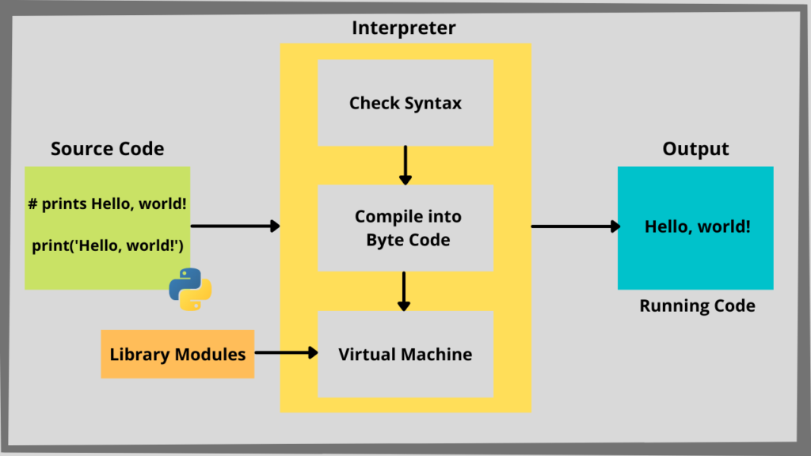
What is different now
So far, we have used python
Python use plain text code and run it though a program called interpreter
Interpreter then convers python code into low level, platform independent byte code (intermediate code)
intermediate code and get execute in the python virtual machine

Slide 3
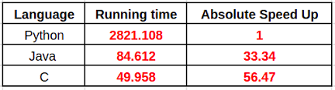
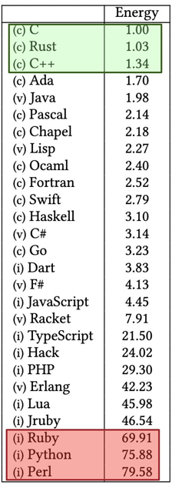
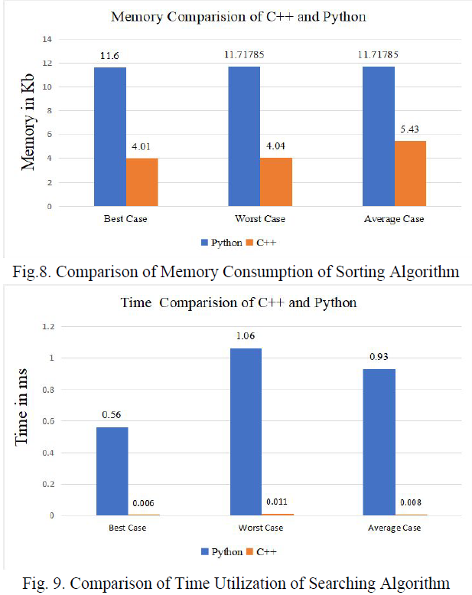
Why compiled code
Python style execution is not efficient for embedded systems. It does not have lot of resource on chip, also it needs to be power efficient, so the code we run needs to be highly optimized.
Python codes are in general NOT optimized
doi:10.20944/preprints202012.0516.v1

Slide 4
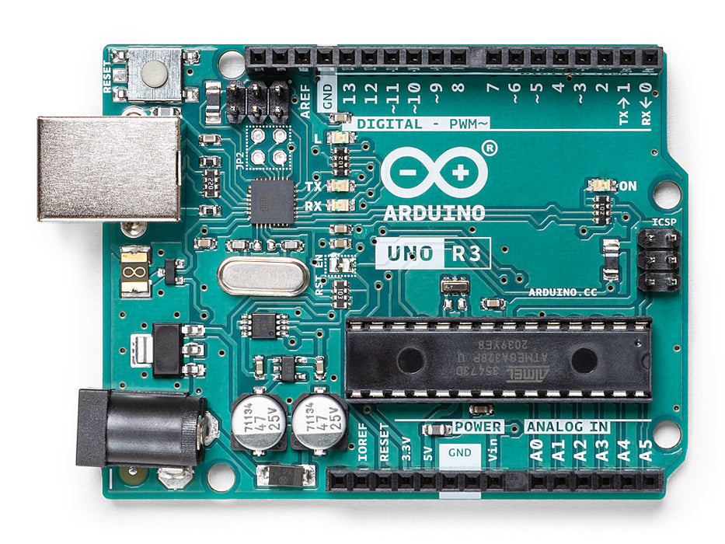
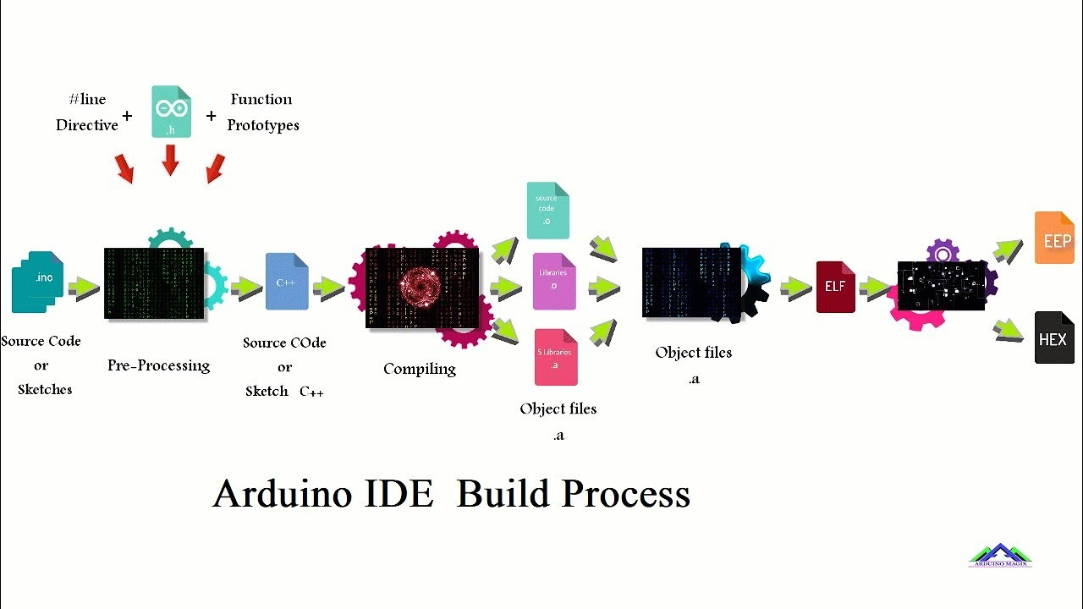
Let’s use C
In this section we will learn how to program Arduino Uno board
Arduino uses language similar to C/C++

Slide 5
How Arduino IDE convert your code
Read your code segment, called sketch and perform a pre-processing to convert it to proper C/C++ code
Then it pass your human readable code through the avr-gcc compiler to build a machine-readable instructions file called object file, you can think this as an intermediary file
Then it combine other information from libraries (link) and create a binary file
This file is then written to the program memory of the chip on the Arduino board

Slide 6
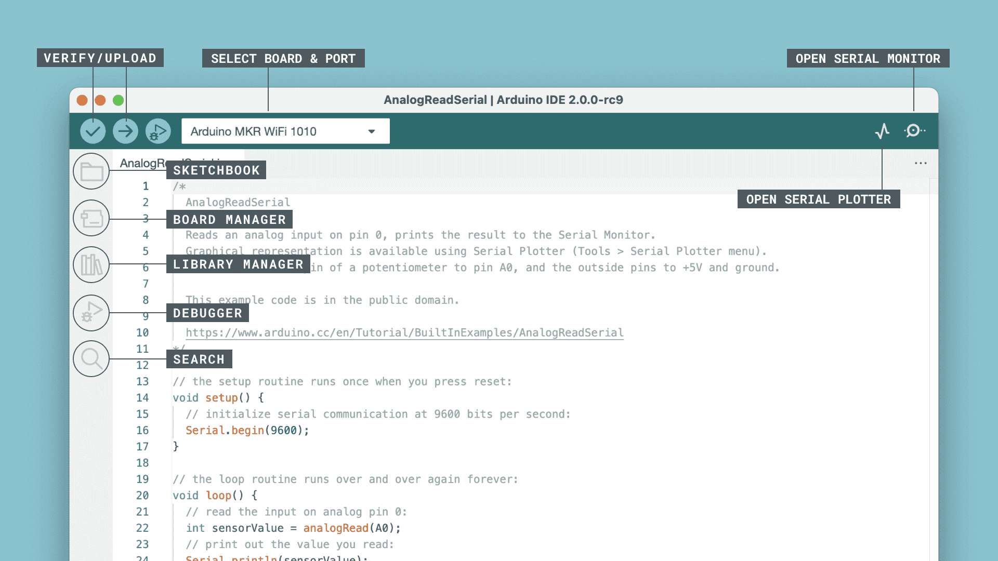

Arduino IDE
Verify / Upload - compile and upload your code to your Arduino Board.
Select Board & Port - detected Arduino boards automatically show up here, along with the port number.
Sketchbook - here you will find all of your sketches locally stored on your computer. Additionally, you can sync with the Arduino Cloud, and also obtain your sketches from the online environment.
Boards Manager - browse through Arduino & third party packages that can be installed. For example, using a MKR WiFi 1010 board requires the Arduino SAMD Boards package installed.
Library Manager - browse through thousands of Arduino libraries, made by Arduino & its community.
Debugger - test and debug programs in real time.
Search - search for keywords in your code.
Open Serial Monitor - opens the Serial Monitor tool, as a new tab in the console

Slide 7
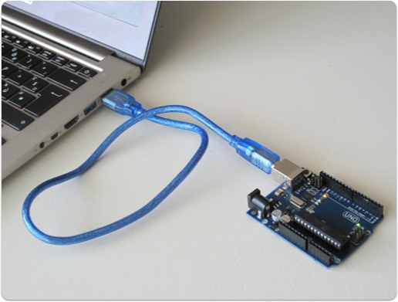
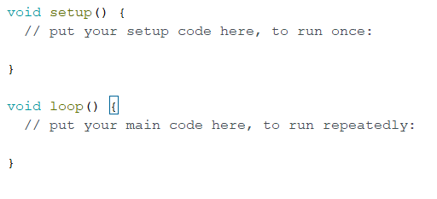
Connect Arduino to the Computer
Open Arduino IDE, see if you can see the USB device there
Now create a new sketch, you will see something like this

Slide 8
Arduino sketch
Arduino sketch has two main sections, setup section only execute once, so you will use this section to do all the initial setup. Loop section runs repetitively, indifferently until device power off. This is where you implement desired action.
One thing to remember is that your code is going to run on a remote device. There is no way to see its execution. We will need to get the output in to the local computer and display it.
Arduino provide serial communications from the device. Let's setup serial communication so that we can see what is going on in the device.

Slide 9
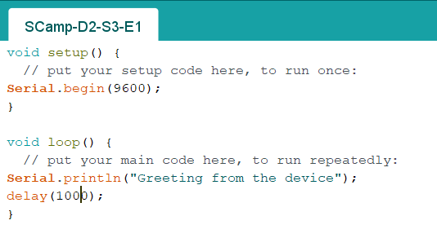
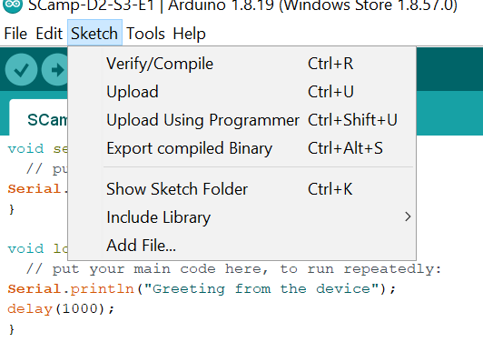
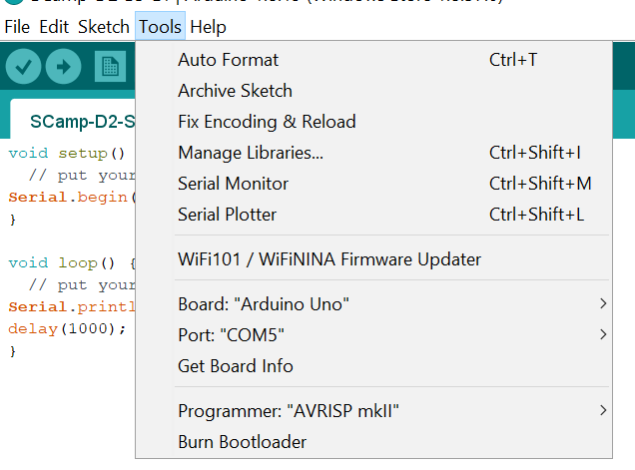
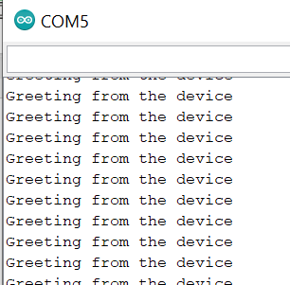
Exercise -1
Open Scamp-D2-S3-E1 file in the Arduino IDE
Compile the code and upload to the device
Open the serial monitor and set the correct baud rate
You should see a line prints every 1s
Congratulations! You ran your 1st Arduino program!

Slide 10
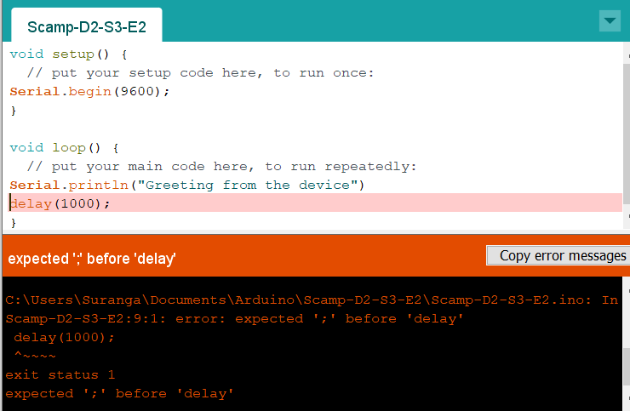
Compiled program
Remember, Arduino IDE compile your program before it load it to the device
What if you have a mistake in your sketch
Open Scamp-D2-S3-E2 file, and repeat same steps as exercise -1
Notice it will not compile
Most of the time, Error massages are self explanatory. However, it is not the case all the time.
In our case, we need to add a ; at the end of the line, before delay(1000);
Each line needs to properly end with a ;

Slide 11
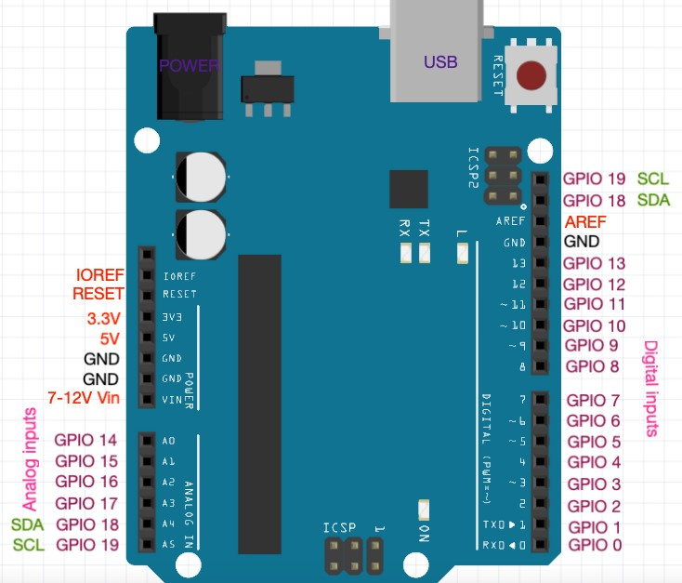
General purpose IO
Ability to controlling external peripheral is a key feature of Arduino boards
Arduino boards provide many general purpose Input output pins that can be controlled by software.
Our car kit has a RGB light that can produce any color
This is basically 3 LEDs , red, green and blue controlled by external controller. Let’s try to produce different colors using Arduino

Slide 12

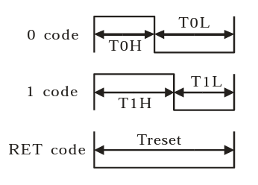
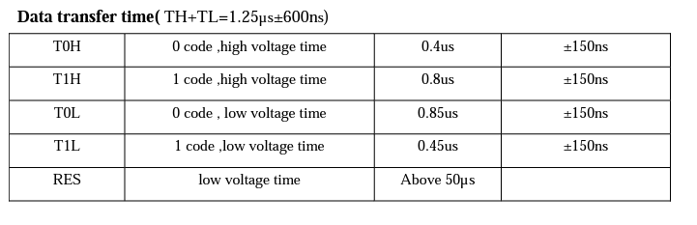
Exercise -1 Control RGB light using Arduino
RGB light consist of controlling circuit. In order to control the color, we need to send a 24-bit signal to the controlling circuit. First 8 bit represent a value of green LED, which can be 0-255, second 8 bit is for the red LED and third is for blue.
Even though we could program this manually, it is very time consuming as we need to make sure correct signal is sent to the device using the IO pin
Each chip manufacturer provide timing specifications for their devices
For our LED timing information is as follows

Slide 13
Control RGB light using Arduino
Now if we need to control the LED, we need to send the correct signal by changing the IO pin status to the correct value, i.e. LOW or HIGH
His is not fun ☹
Luckily usually there is someone, already spent time and write these instruction as functions and make it available as a library.
It will save a lot of time, if we can find an already available library for our task in hand.
For this project we will use a library called, FastLED. https://github.com/FastLED/FastLED

Slide 14
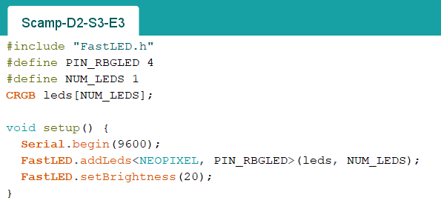
Control RGB light using Arduino
With this library we can write a simple program to control the RGB light
Please Open Scamp-D2-S3-E3 file
In the first like we have included FastLED.h file. This file contain all the definitions needed to call functions defined in the FastLED library. This will tell Arduino IDE to use these definition during pre-compilation
Note that the LED is connected to Pin number D4 and we only have one LED

Slide 15
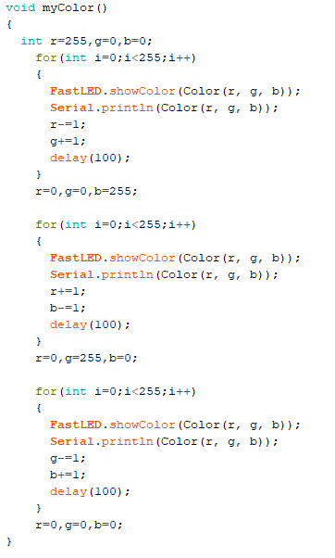
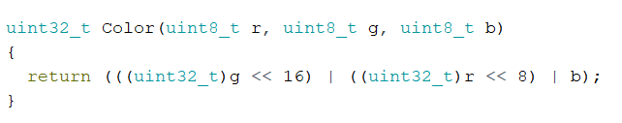
Control RGB light using Arduino
Now we need to create 24-bit signal. Our goal is to change the color of the LED incrementally.
Following two functions will achieve it

Slide 16
Control RGB light using Arduino
Let’s take a close look at the code, especially C data types
During the python session we did not pay our attention to the data types as we should do, this is because python, most of the time, automatically store data in most efficient way. Btw, python is not efficient in most part ☺
However, C on the other hand requires you to pay close attention to details.
In our code we define each color as uint8_t, it is unsigned integer of length 8. a byte.
Now we define the color as uint32_t, which is unsinged integer if length 32
Then we convert g and r to different data type, (uint32_t)g this is called casting
<< operator shift the data to the left, so we shift green 16 places and red 8 places
They we take | operator. This is OR operator. Final product is 24 bit signal we need to send to control chip.

